Slide 1
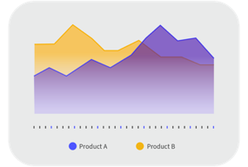
Testing Best Practices
CLOUDSUITE SOLUTIONS
2025 SUN Elevate
Chris Weaver, Matt Agler, Mike Huston
February 26, 2025

Slide 2
Full disclaimer
This presentation reflects the direction Infor may take with regard to the products or services described herein, all of which is subject to change without notice. This presentation is not a commitment to you in any way and you should not rely on any content herein in making any decision. Infor is not committing to develop or deliver any specified enhancement, upgrade, product, service or functionality, even if such is described herein. Many factors can affect Infor’s product development plans and the nature, content and timing of future product releases, all of which remain in the sole discretion of Infor. This presentation, in whole or in part, may not be incorporated into any agreement. Infor expressly disclaims any liability with respect to this presentation.
Notes:
Full disclaimer is a mandatory inclusion on all presentations. It can be placed at the beginning or end of your presentation.

Slide 3
Why We are Here
In this session we will cover extensibility best practices and testing automation. Follow along in this hands on training to build test cases against CSI using an opensource testing platform.

Slide 4

Solution Overview
2025 SUN Elevate Testing Best Practices
What is Test Automation?
the practice of using software tools to automatically execute pre-written test scripts, allowing for the repeated and efficient validation of software functionality without manual intervention
Why Playwright?
Playwright is a popular test automation framework that's used to test web applications across browsers and platforms. It's a good choice because it's easy to use, has a unified API, and supports many programming languages.
Cross-browser compatibility: Works with all major browsers, including Chrome, Edge, Firefox, and Safari
Cross-platform capability: Runs on Windows, Linux, and macOS
Supports multiple programming languages: Includes JavaScript, Python, Java, TypeScript, and .NET
Built-in wait mechanisms: Automatically waits for elements to be ready, which reduces flakiness
Test isolation: Each test runs in a separate browser context, so tests don't interfere with each other
Advanced testing: Can test complex workflows, including multiple tabs, users, or contexts
Debugging tools: Includes the Playwright Inspector, Codegen, and Trace Viewer to create, inspect, and debug tests
Parallel testing: Can run tests in parallel in the same file
Notes:
https://stackoverflow.com/questions/1196415/what-datatype-to-use-when-storing-latitude-and-longitude-data-in-sql-databases

Slide 5
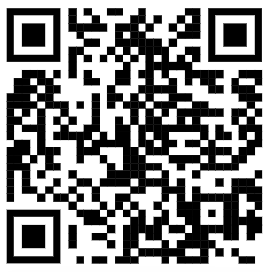
Housekeeping
2025 SUN Elevate IDO Extension and Application Development
https://mingle-portal.inforcloudsuite.com/v2/SLSGDENA209_AX1
Username & Password available at your terminal
Code can be found on github at the following location
https://github.com/vaewc/pw
Notes:
Admin UID: ElevateD2RF_00 Admin PWD: SUNConf@dminD2RF

Slide 6
02 Installation
2025 SUN Elevate Testing Best Practices

Slide 7

Personlization Schema
2025 SUN Elevate IDO Extension and Application Development
Installation Overview
Install Node.js v 18.20.6 (LTS)
Install Playwright
Install Visual Studio Code
Install Playwright plugin for VS Code
Execute initial tests
Notes:
https://stackoverflow.com/questions/1196415/what-datatype-to-use-when-storing-latitude-and-longitude-data-in-sql-databases

Slide 8
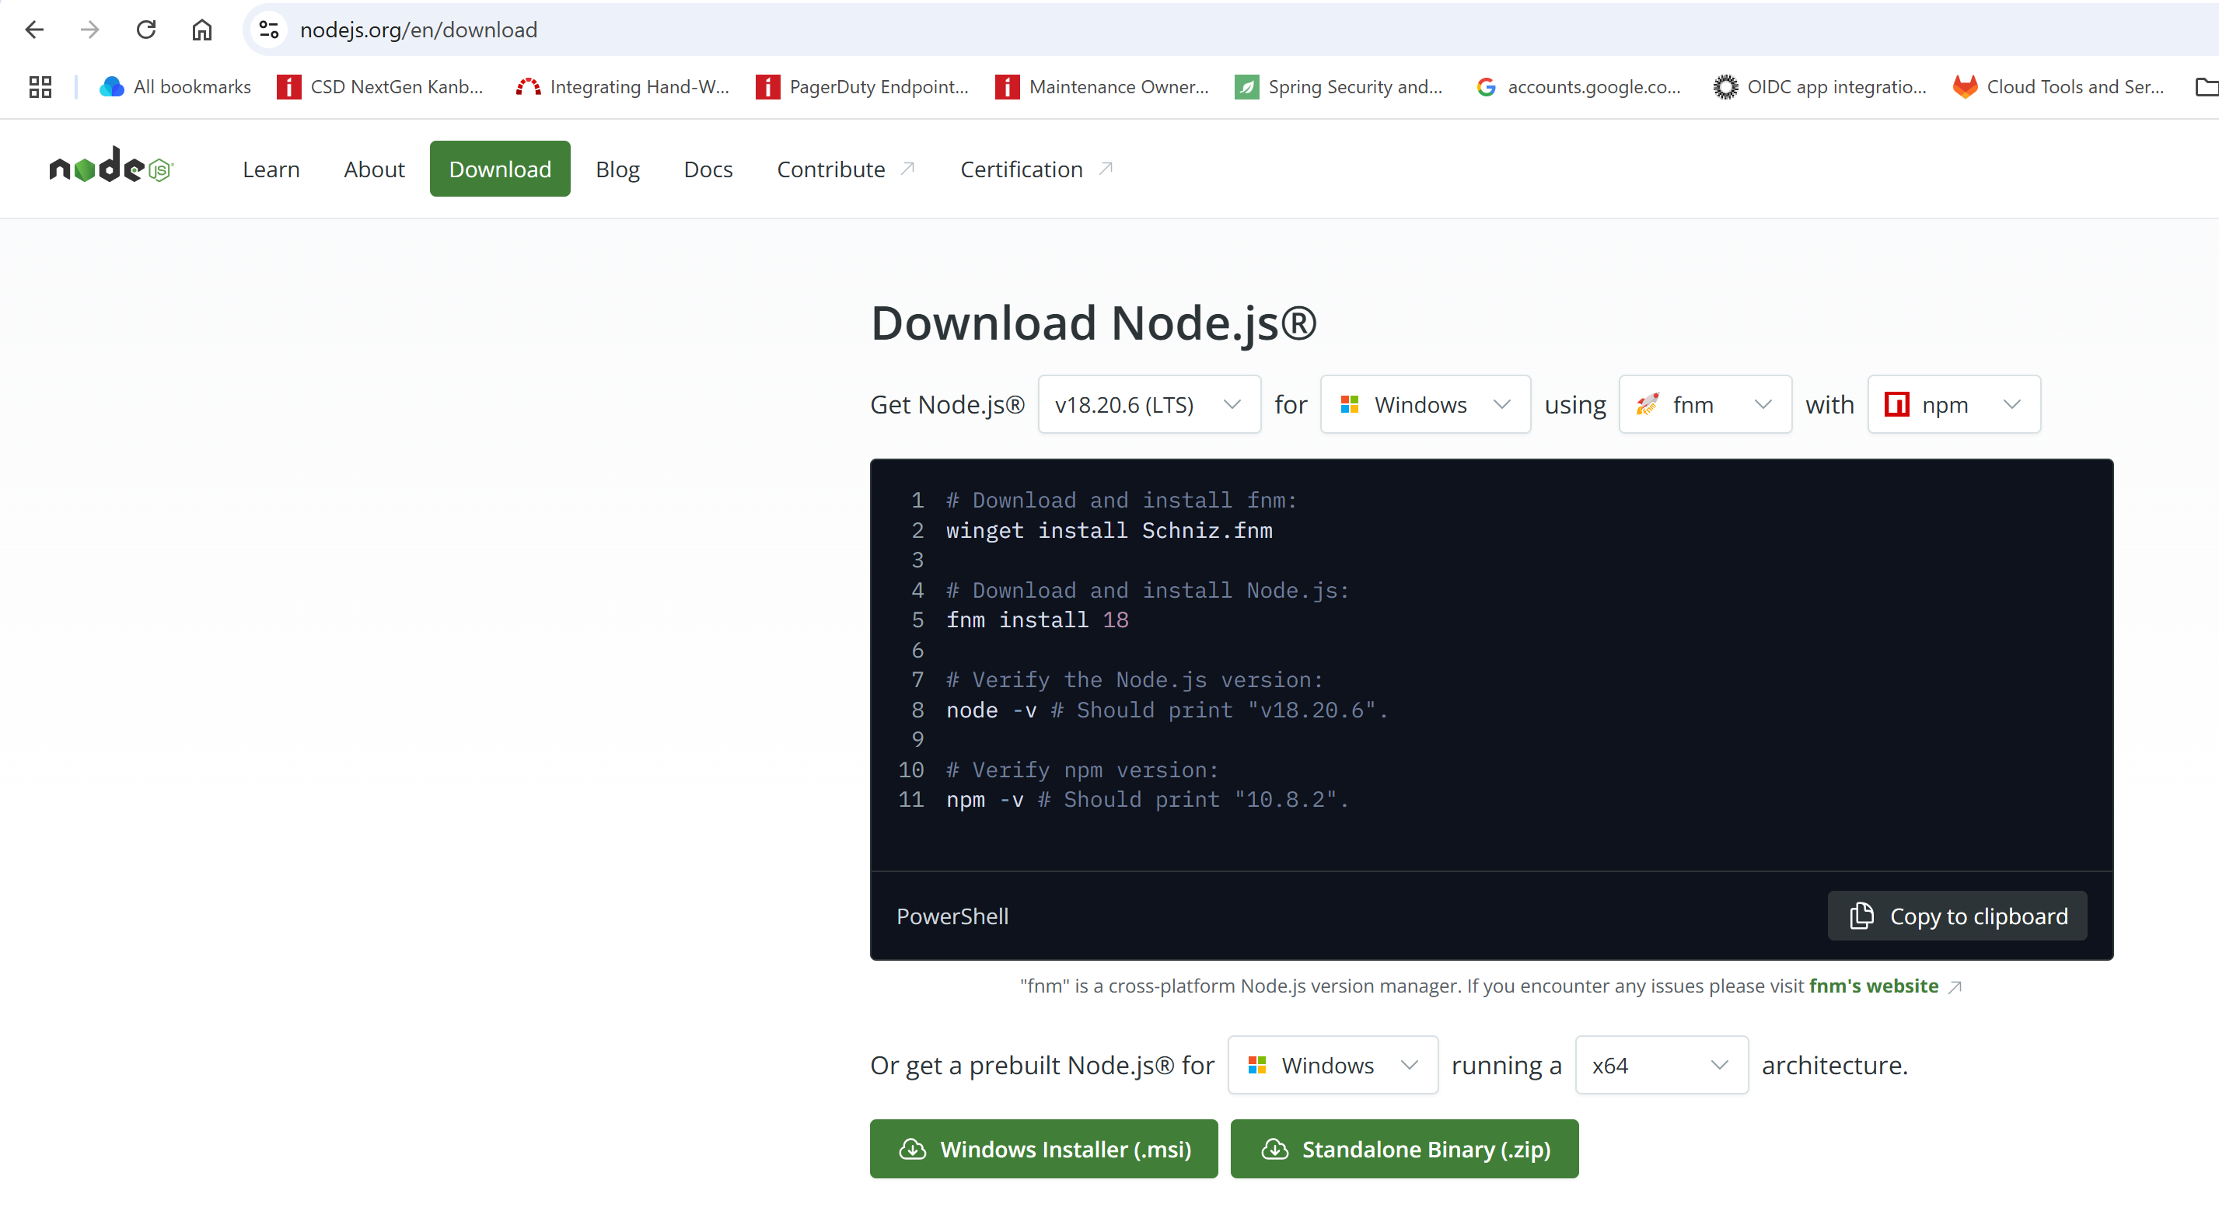
Personlization Schema
2025 SUN Elevate IDO Extension and Application Development
Install Node.js v 18.20.6 (LTS)
https://nodejs.org/en/download
Direct download: https://nodejs.org/dist/v18.20.6/node-v18.20.6-x64.msi
Launch installer and follow prompts. Choosing defaults will be acceptable for most installations.
Notes:
https://stackoverflow.com/questions/1196415/what-datatype-to-use-when-storing-latitude-and-longitude-data-in-sql-databases

Slide 9
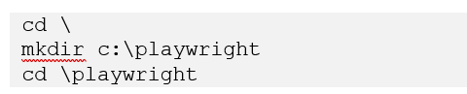
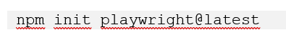
Personlization Schema
2025 SUN Elevate IDO Extension and Application Development
Install Playwright
Open a windows command prompt and create a directory where playwright will be installed, this will be the location where tests will be created
Install Playwright using npm (installed when node.js is installed
Notes:
https://stackoverflow.com/questions/1196415/what-datatype-to-use-when-storing-latitude-and-longitude-data-in-sql-databases

Slide 10
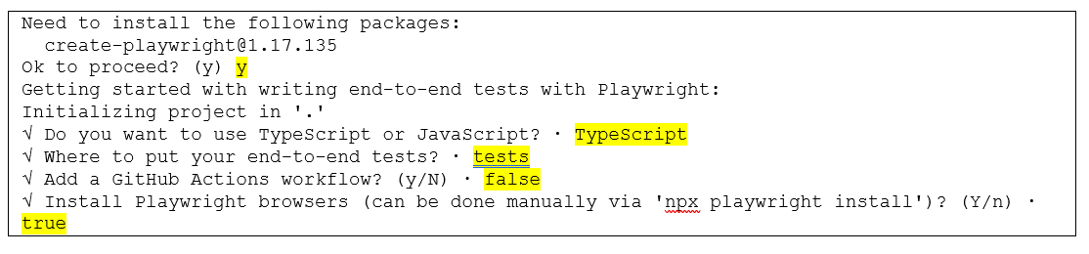
Personlization Schema
2025 SUN Elevate IDO Extension and Application Development
Install Playwright
At each prompt, answer with highlighted value
Notes:
https://stackoverflow.com/questions/1196415/what-datatype-to-use-when-storing-latitude-and-longitude-data-in-sql-databases

Slide 11
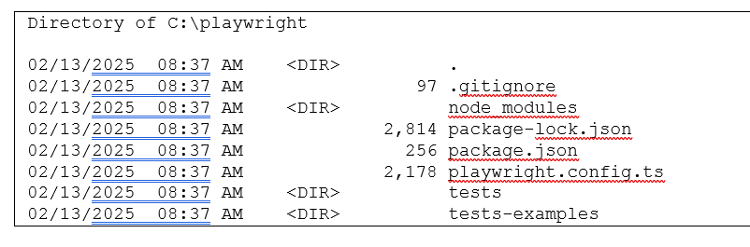
Personlization Schema
2025 SUN Elevate IDO Extension and Application Development
Install Playwright
Once installation is complete, you should see a directory structure similar to the following:
Notes:
https://stackoverflow.com/questions/1196415/what-datatype-to-use-when-storing-latitude-and-longitude-data-in-sql-databases

Slide 12
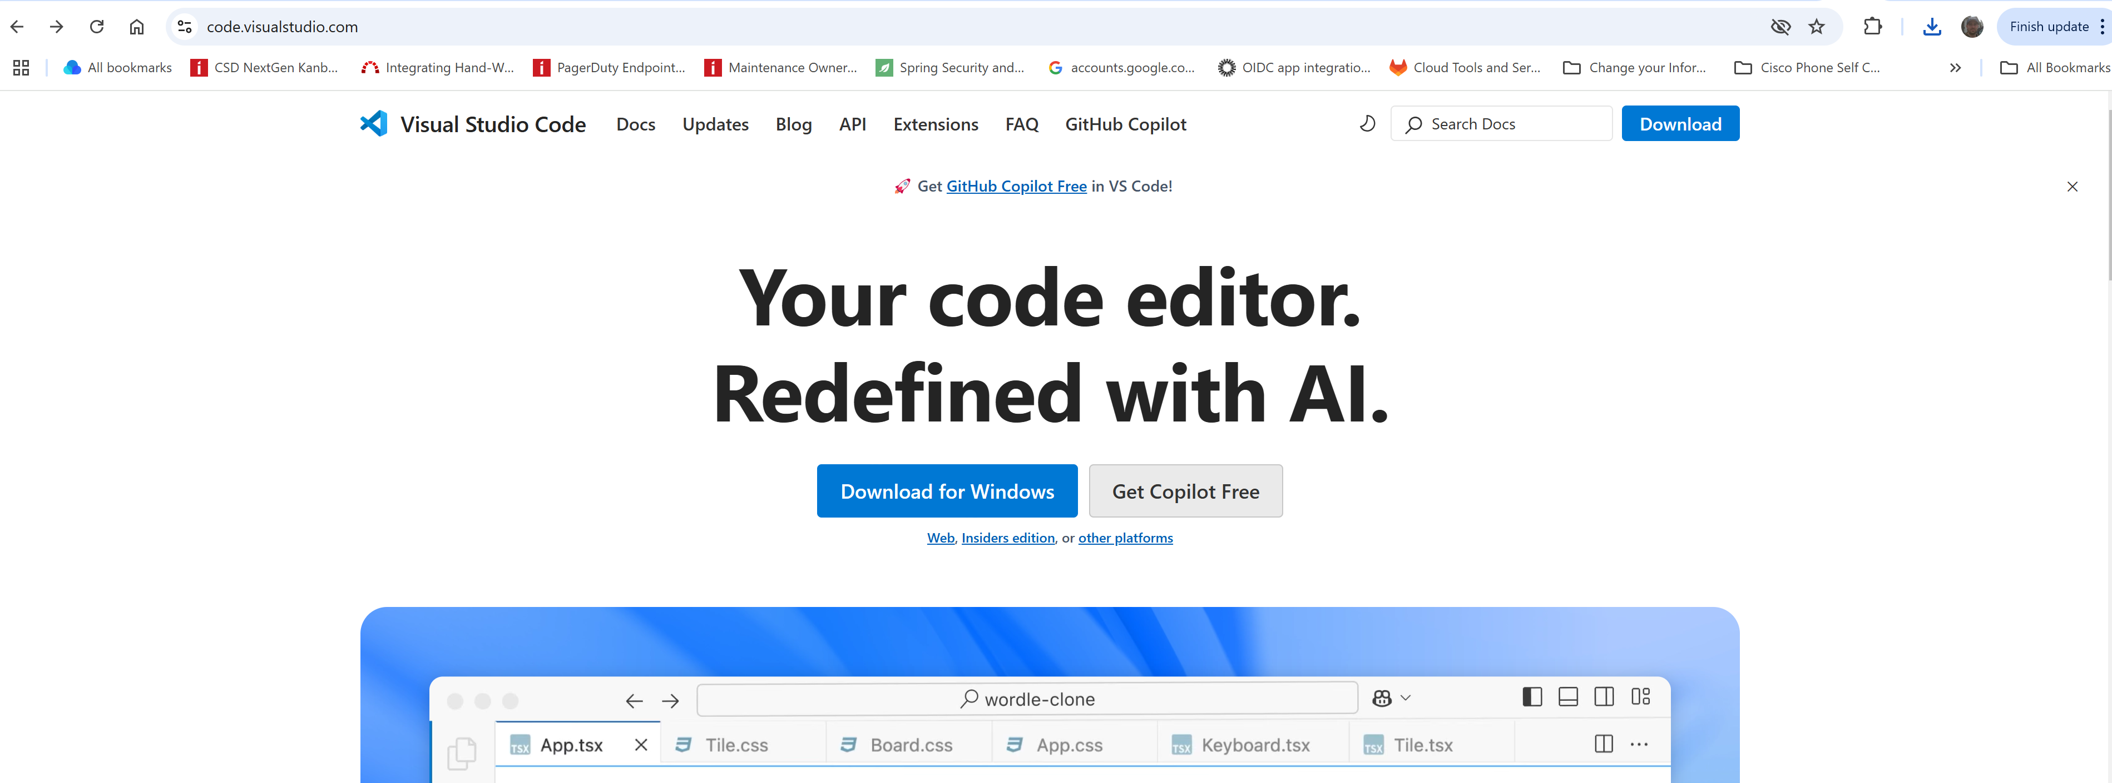
Personlization Schema
2025 SUN Elevate IDO Extension and Application Development
Install Visual Studio Code
https://code.visualstudio.com/
Direct download link https://code.visualstudio.com/sha/download?build=stable&os=win32-x64-user
Launch installer and follow prompts. Choosing defaults will be acceptable for most installations.
Notes:
https://stackoverflow.com/questions/1196415/what-datatype-to-use-when-storing-latitude-and-longitude-data-in-sql-databases

Slide 13
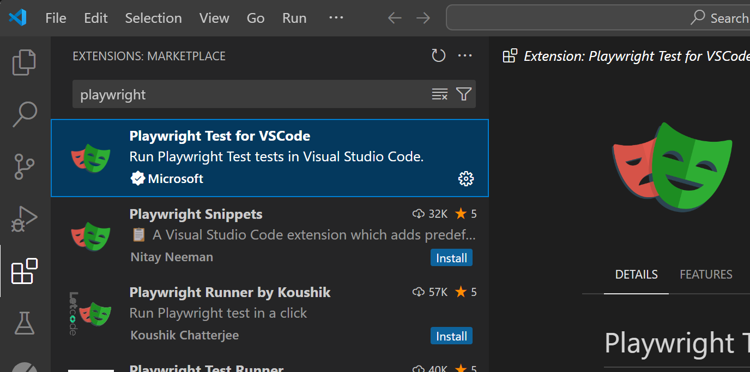
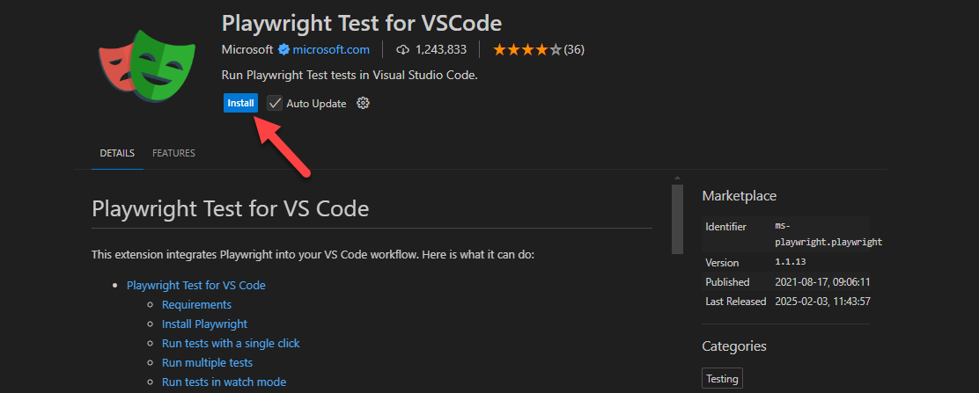
Personlization Schema
2025 SUN Elevate IDO Extension and Application Development
Install Playwright plugin for VS Code
Launch VS Code, click extensions icon in left navigation pane, search for ‘playwright’ in the filter.
Choose ‘Playwright Test for VSCode’
Notes:
https://stackoverflow.com/questions/1196415/what-datatype-to-use-when-storing-latitude-and-longitude-data-in-sql-databases

Slide 14
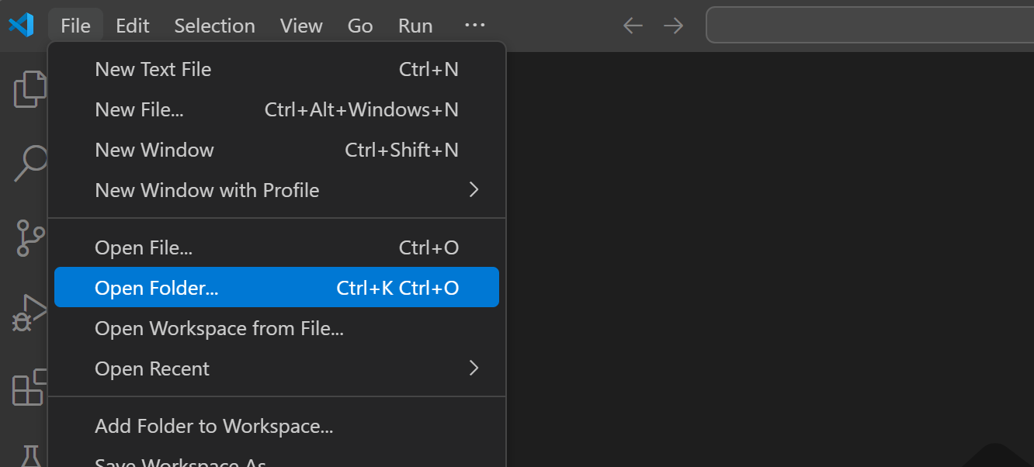
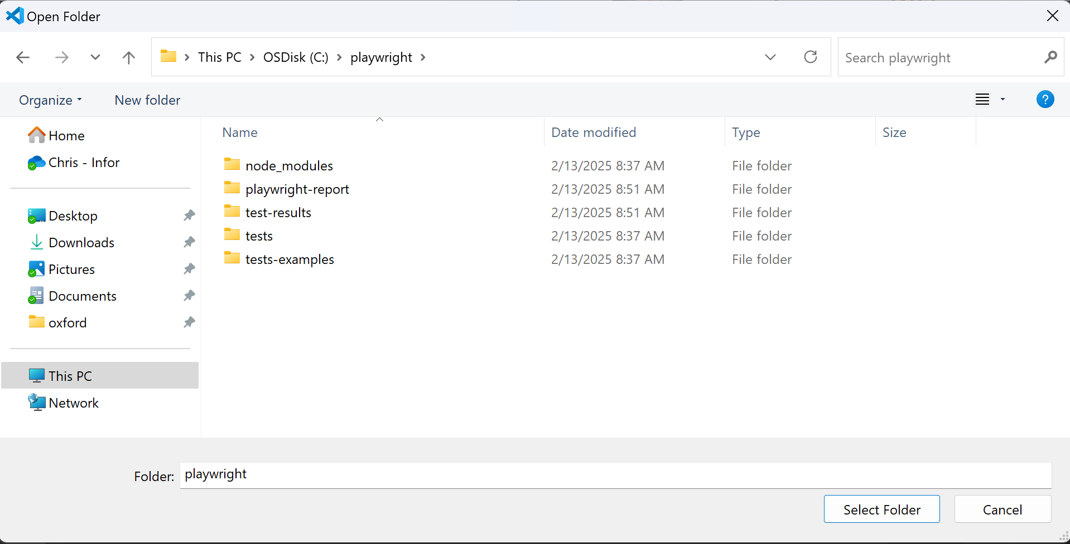
Personlization Schema
2025 SUN Elevate IDO Extension and Application Development
Execute Initial Tests
Open the previously created Playwright project with VS Code. File -> Open Folder
Navigate to c:\playwright, click ‘Select Folder’
Notes:
https://stackoverflow.com/questions/1196415/what-datatype-to-use-when-storing-latitude-and-longitude-data-in-sql-databases

Slide 15
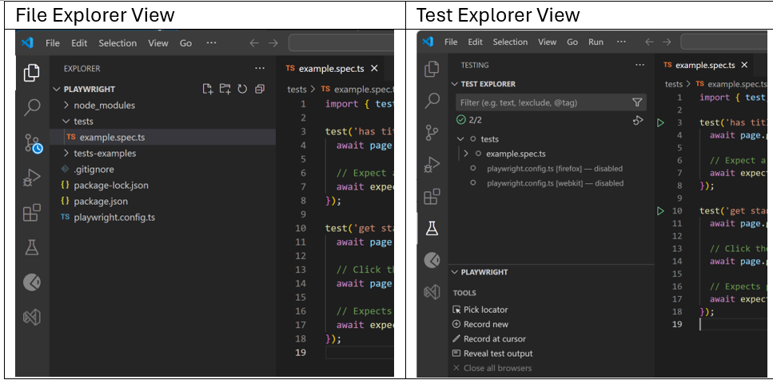
Personlization Schema
2025 SUN Elevate IDO Extension and Application Development
Execute Initial Tests
You should now see the files created by the playwright init tool in the File Explorer, as well as an example test case in the Test Explorer
Notes:
https://stackoverflow.com/questions/1196415/what-datatype-to-use-when-storing-latitude-and-longitude-data-in-sql-databases

Slide 16
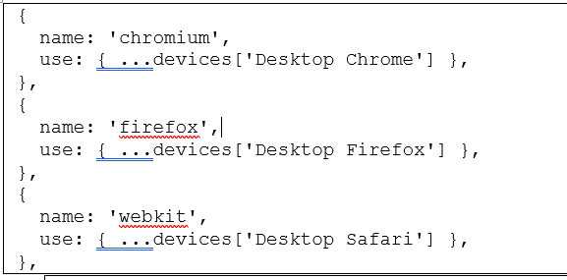
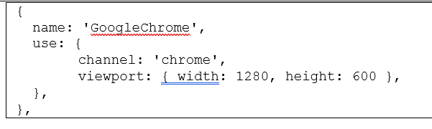
Personlization Schema
2025 SUN Elevate IDO Extension and Application Development
Playwright can test against multiple browsers, for now we will configure the tool to use google chrome.
Execute Initial Tests
From the File Explorer, open ‘playwright.config.ts’
Look for the projects section and remove the following browser settings
Add the following to the project section
Notes:
https://stackoverflow.com/questions/1196415/what-datatype-to-use-when-storing-latitude-and-longitude-data-in-sql-databases

Slide 17
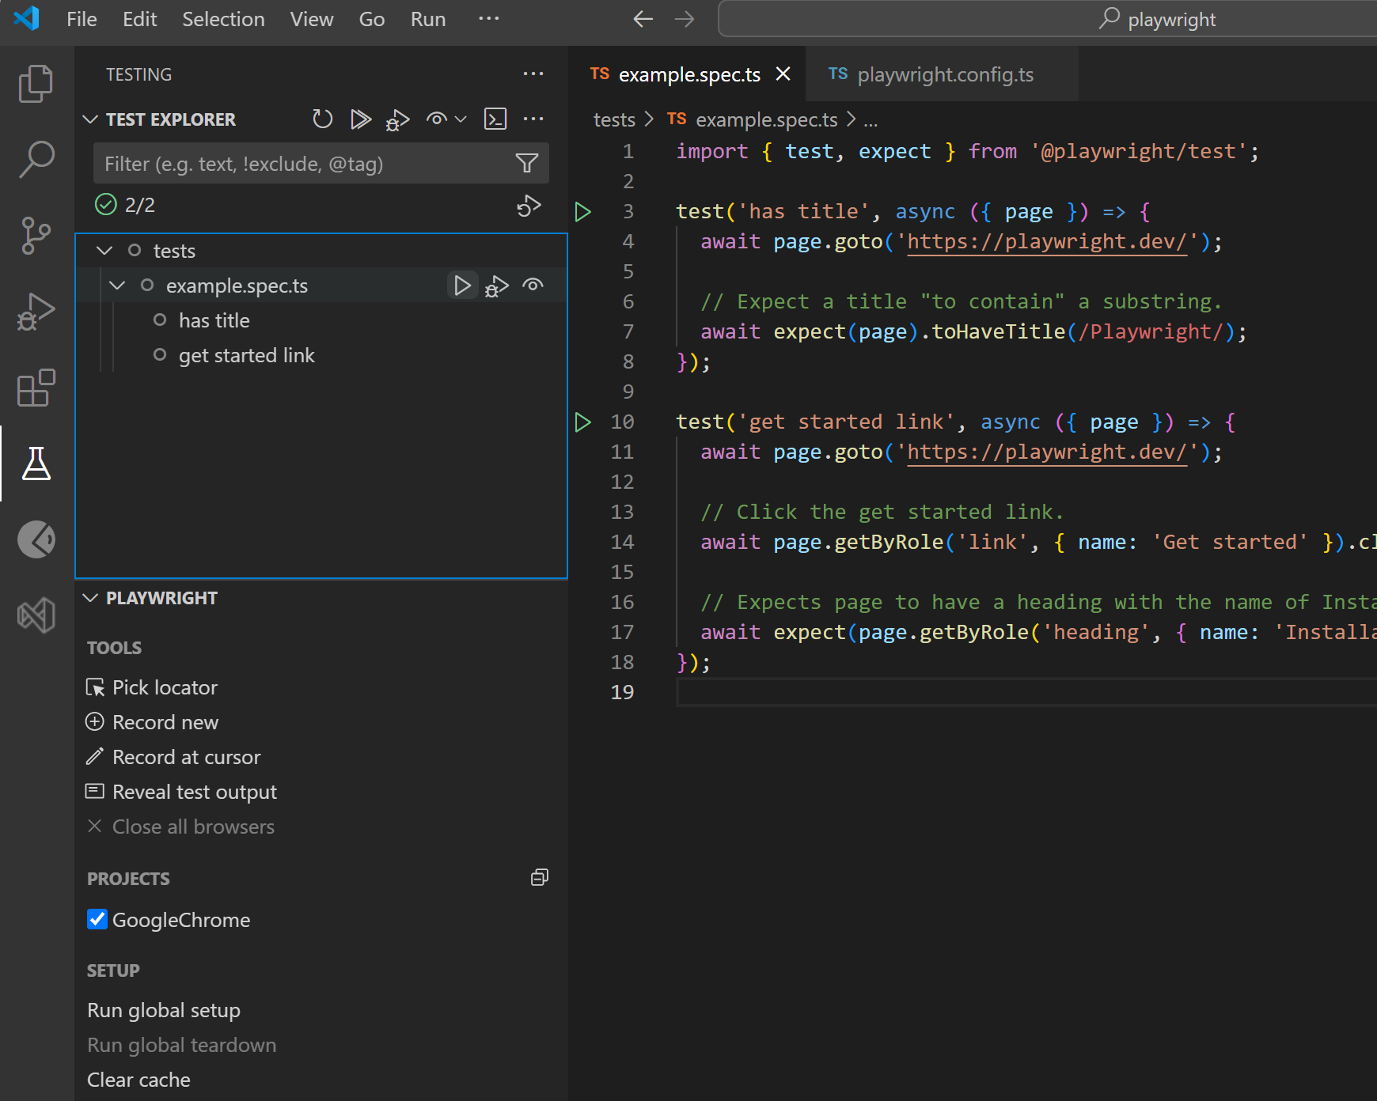
Personlization Schema
2025 SUN Elevate IDO Extension and Application Development
Execute Initial Tests
Navigate to the Test Explorer, expand tests. From here you are able to run and debug tests.
Notes:
https://stackoverflow.com/questions/1196415/what-datatype-to-use-when-storing-latitude-and-longitude-data-in-sql-databases

Slide 18

Personlization Schema
2025 SUN Elevate IDO Extension and Application Development
Execute Initial Tests
Click on the ‘run’ icon to the right of ‘example.spec.ts’. This will launch a chrome browser and step through the individual tests (if there is more than one)
Notes:
https://stackoverflow.com/questions/1196415/what-datatype-to-use-when-storing-latitude-and-longitude-data-in-sql-databases

Slide 19
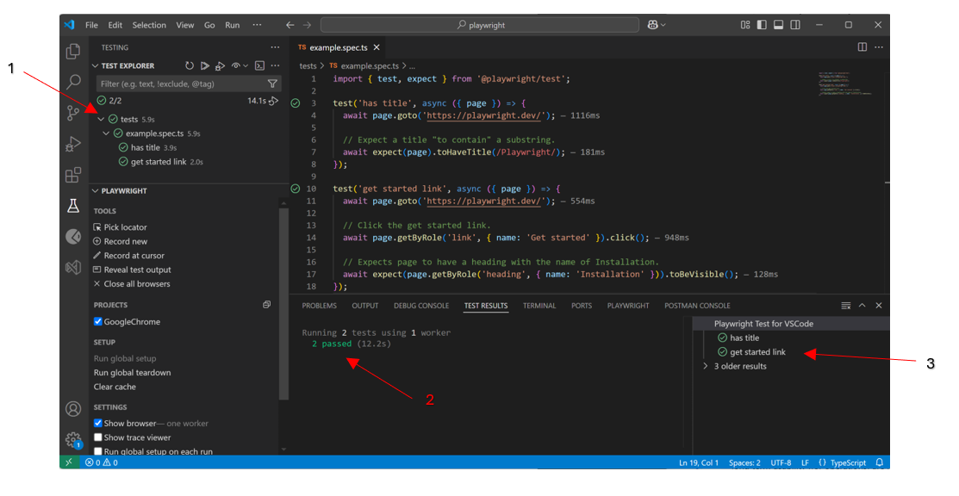
Personlization Schema
2025 SUN Elevate IDO Extension and Application Development
Execute Initial Tests
Once the test is complete, if successful you will see a few indicators.
This is an indicator of the test status
This section will show the number of pass / fail tests
This will show the detailed test status when a
Notes:
https://stackoverflow.com/questions/1196415/what-datatype-to-use-when-storing-latitude-and-longitude-data-in-sql-databases

Slide 20
2025 SUN Testing Best Practices
Thank you!
Chris Weaver
VP, Software Development
chris.weaver@infor.com

